Slide 1


Reinforcement Learning for Energy Storage Arbitrage
DS II Final Project Presentation
Micah Botkin-Levy
University of Vermont
Spring 2019

Slide 2
Overview of Presentation
Introduction
Motivation
Energy Storage Systems Dynamics
Energy Storage Arbitrage Algorithms
Comparison of Simulated Methods
Conclusions and Future Work

Slide 3



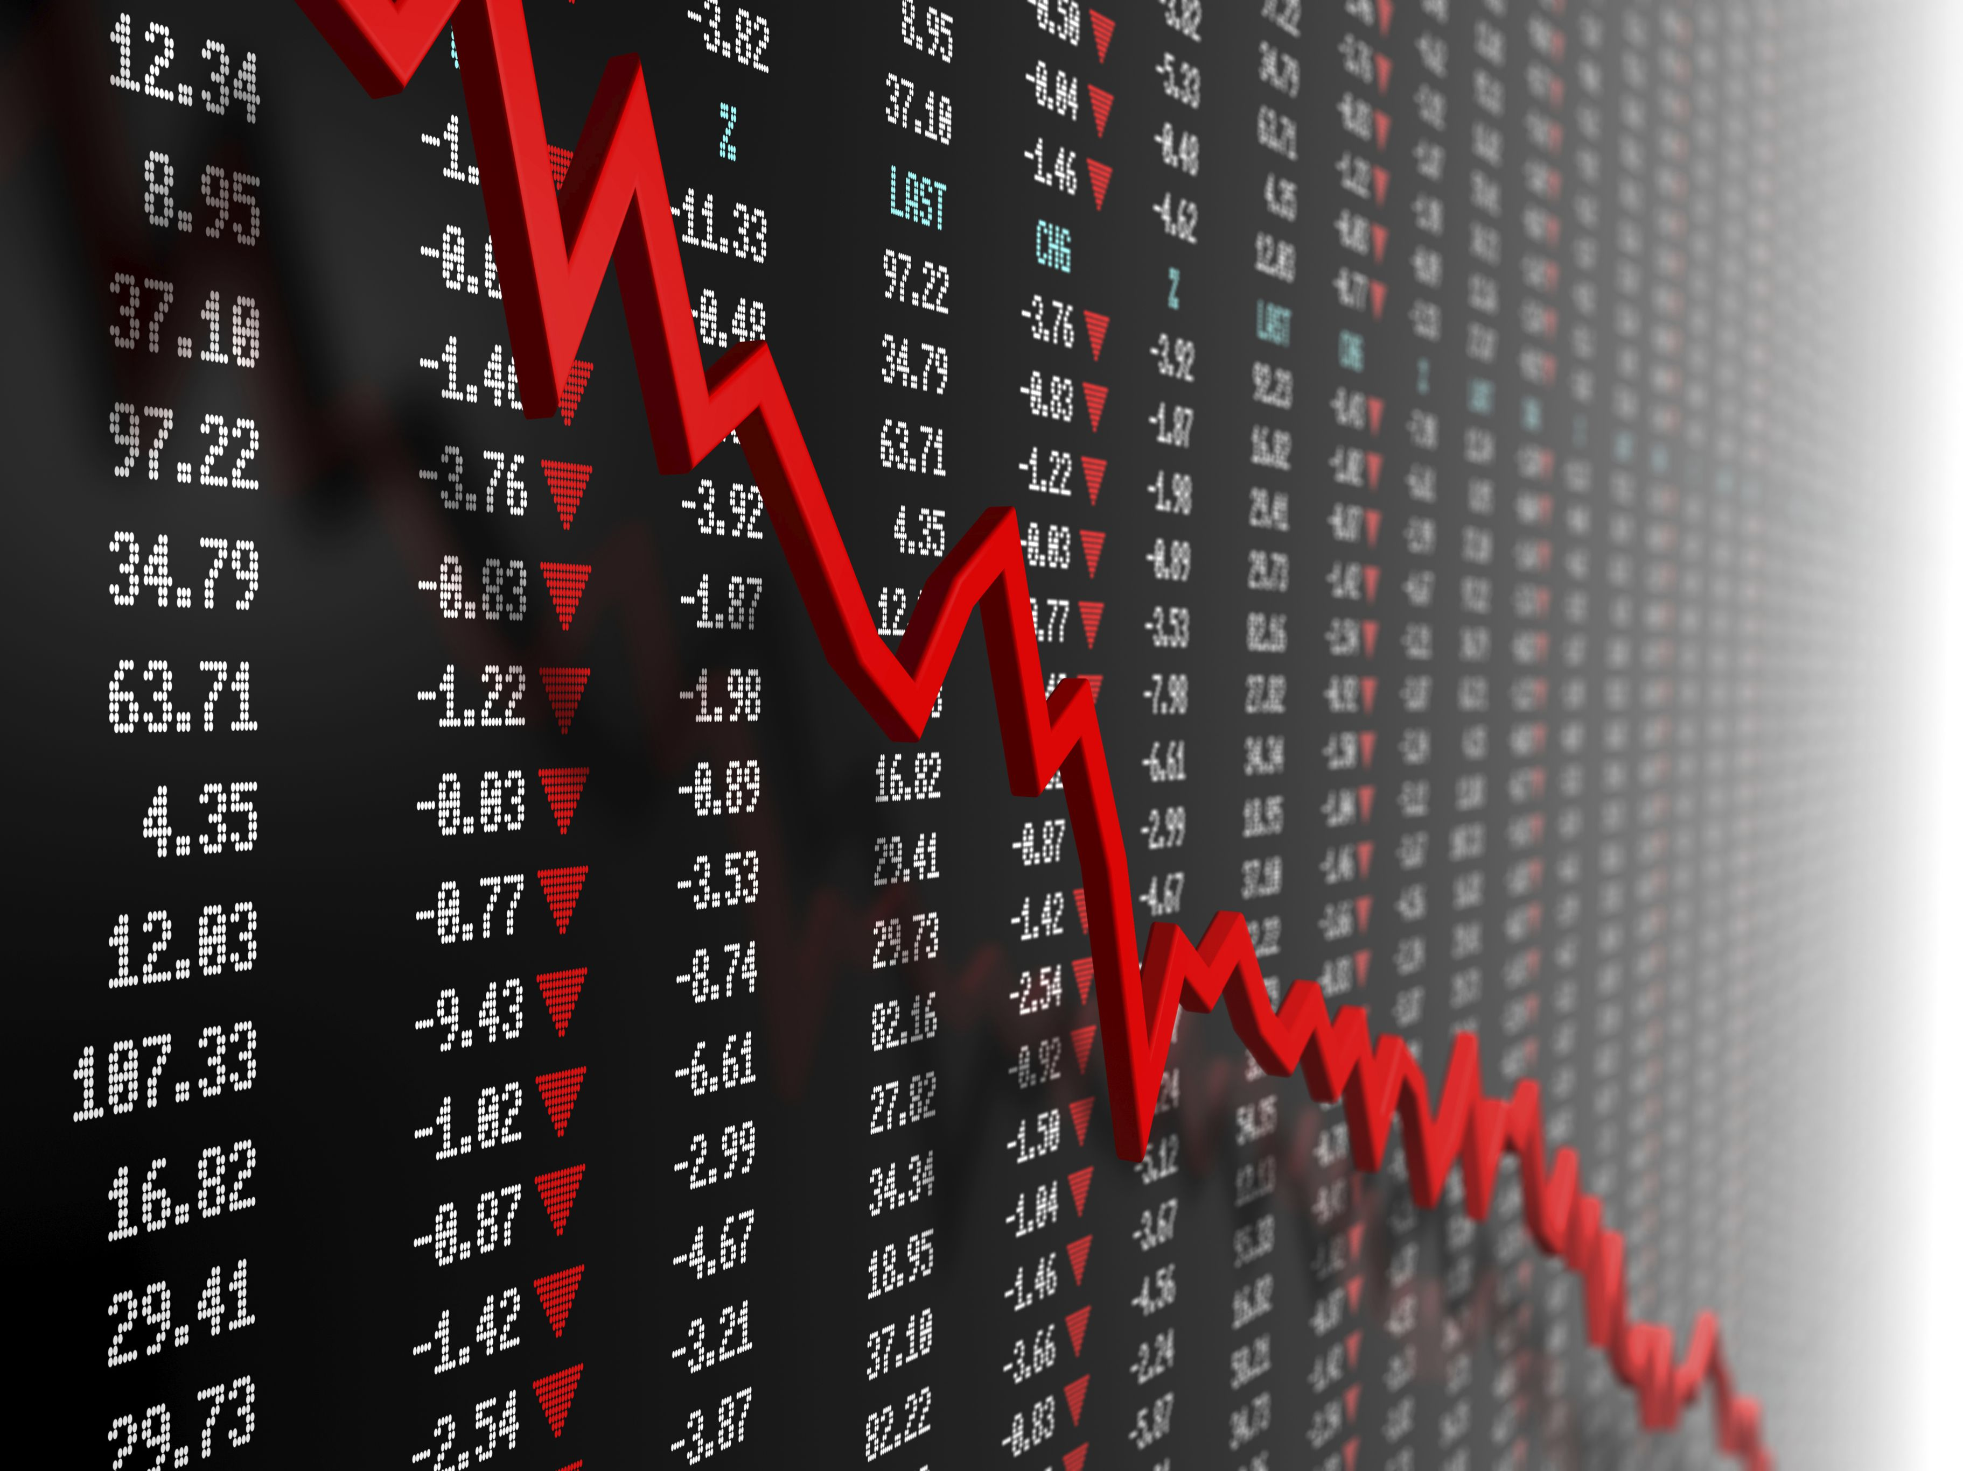
Overview & Motivation

Slide 4
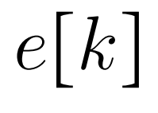
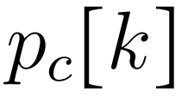
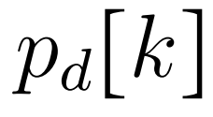
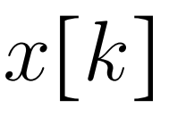
Notation
Energy in ESS
Charging Power
Discharge Power
Real-time Energy Price

Slide 5
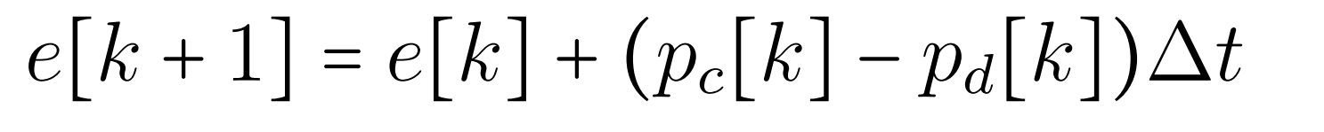
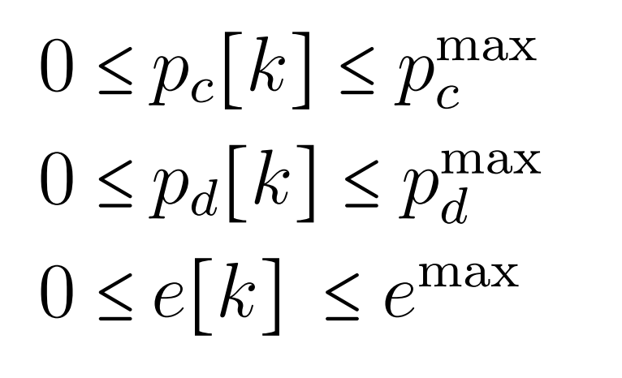

Energy Storage System Model
Energy Dynamics
Physical Constraints

Slide 6
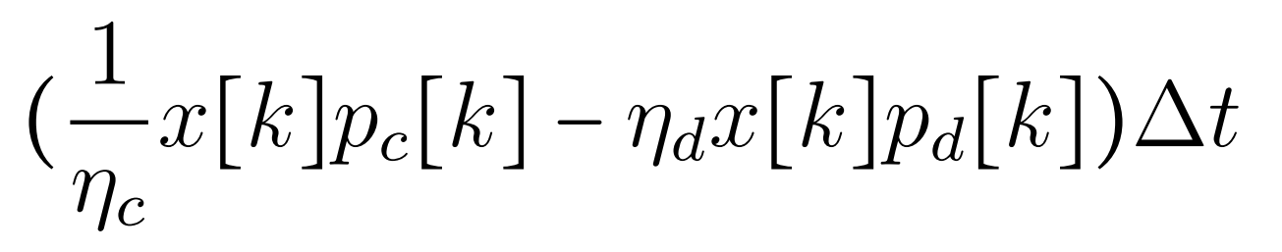
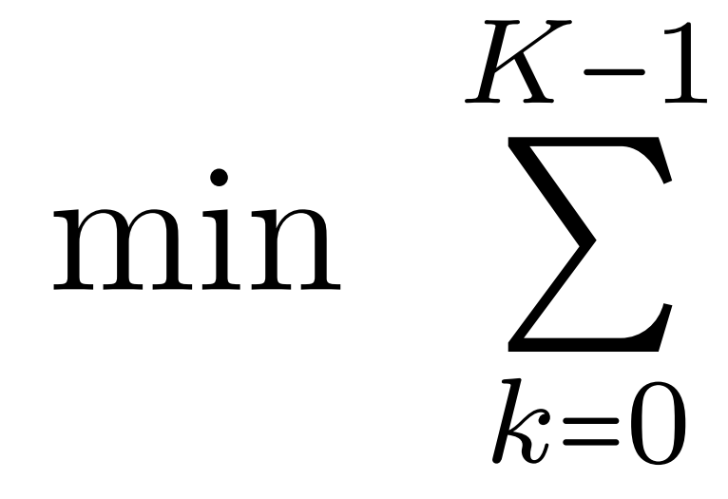
Energy Arbitrage Cost Function
Energy Purchases
Energy Sales

Slide 7

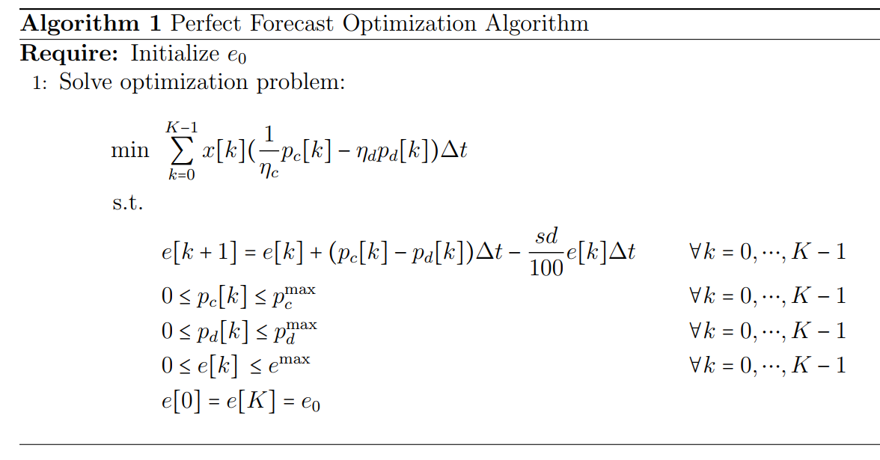
Optimal Algorithm

Slide 8

Reinforcement Learning
Actions: Charge at Max, Do Nothing, Discharge at Max
State: Energy Level & Energy Price
Reward: - Energy Arbitrage Cost Function

Slide 9
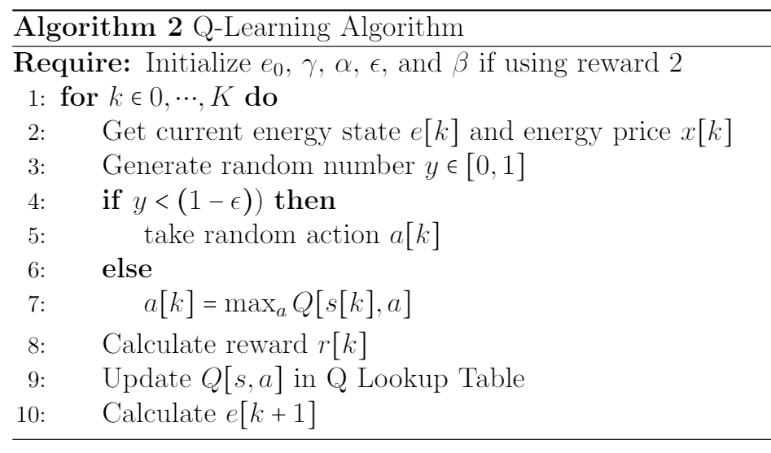
Q-Learning Algorithm

Slide 10
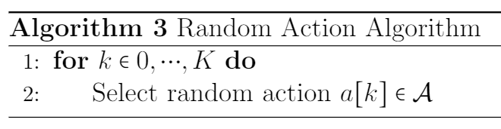

Random Action Algorithm

Slide 11
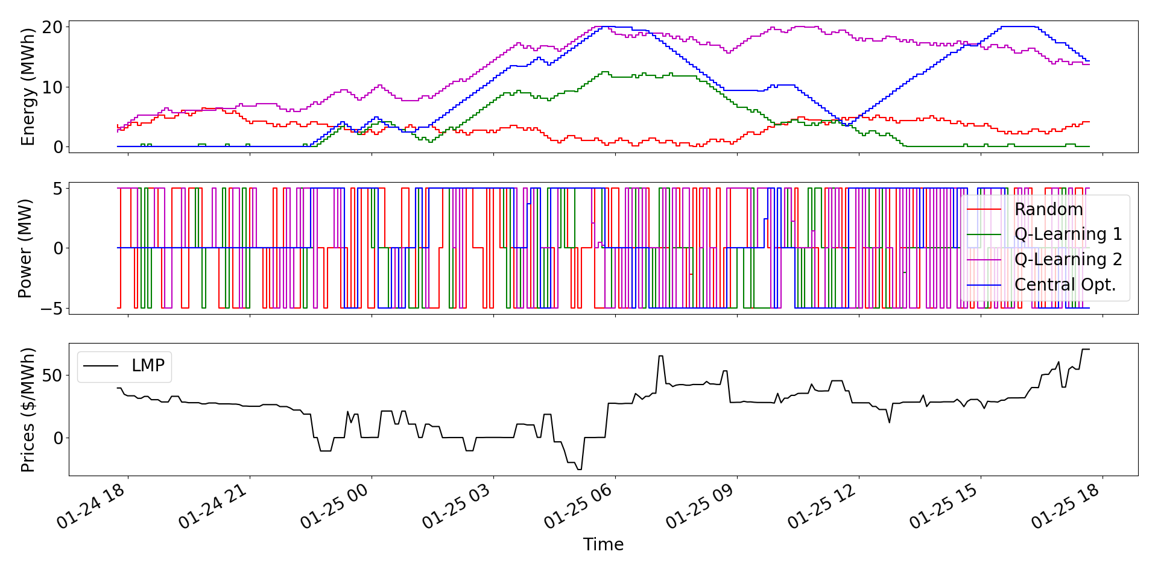
Sample Energy Storage Control

Slide 12
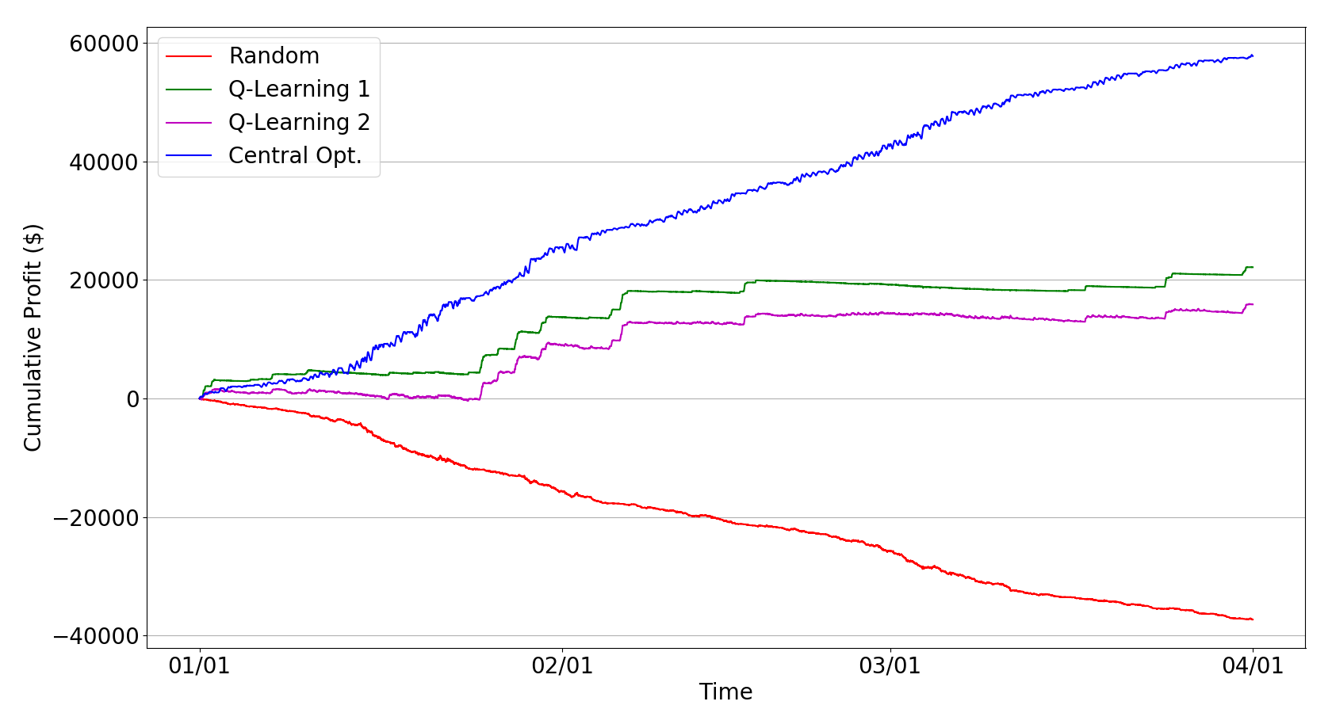
Cumulative Profit

Slide 13
Conclusions
Q learning able to control ESS for energy arbitrage profit
No price forecast
No external information besides price
Extremely quick computation
Future Work
Deep Q Learning
Battery Degradation

Slide 14

Thank you!
Contact info
Micah Botkin-Levy
mbotkinl@uvm.edu

Slide 15
Image References
http://www.restless.org.uk/
https://www.thebalance.com/how-falling-stock-prices-can-make-you-rich-358152
https://energy.mit.edu/research/future-solar-energy/
https://www.japanindustrynews.com/2016/09/japan-eyes-wind-farms-power-energy-needs-sets-ambitious-goals/
https://www.bbc.com/news/technology-36311668
https://www.kdnuggets.com/2018/03/5-things-reinforcement-learning.html
https://www.amazon.com/Amlong-Crystal-Clear-Redwood-Resin/dp/B01BCS7J3Y

